Slide 1
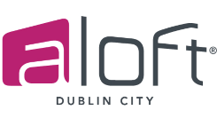
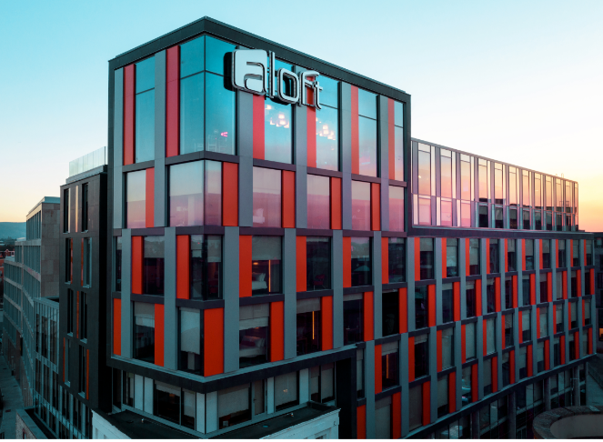
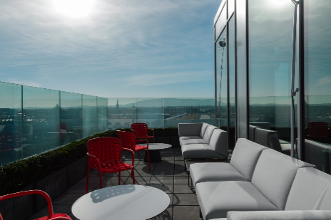
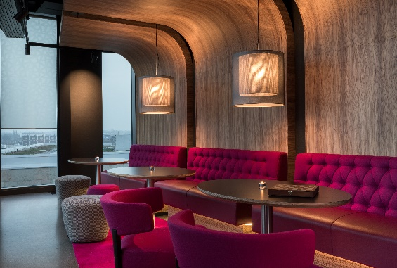
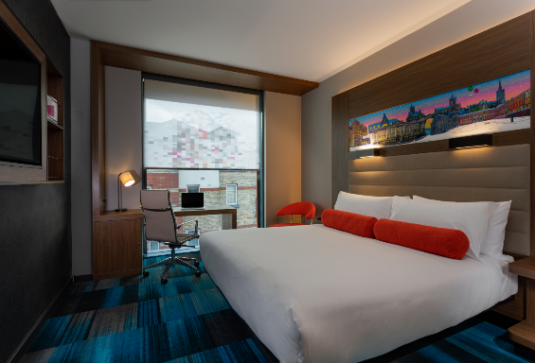
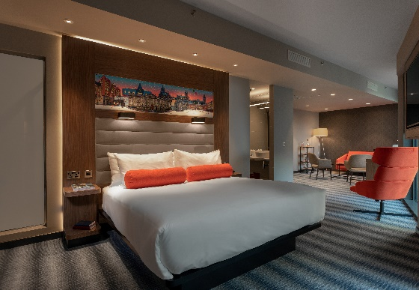
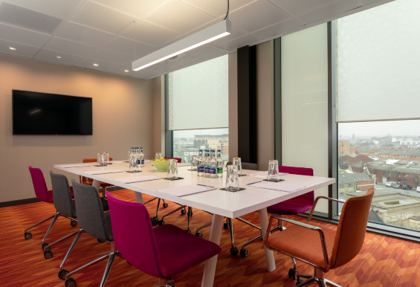
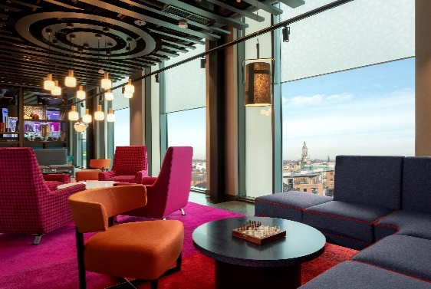
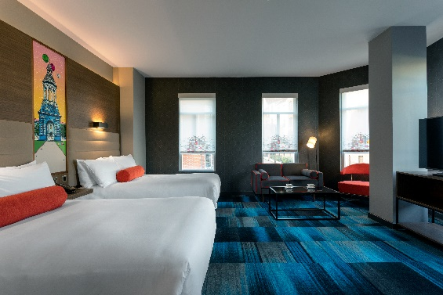
1 Mill Street,
The Liberties, Dublin,
DO8 XK58, Ireland
Tel: +353.1.963.1800
Fax: +353.1.526.6417
https://www.marriott.com/hotels/maps/travel/dubal-aloft-dublin-city/
Total Floors: 7
Total Sleeping Rooms: 202
Total Meeting Rooms: 4
Property Overview:
Stay and play in style at the new Aloft Dublin City Hotel opened Feb 2019, Full service designed for the savvy tech needs. We are located in one of the most historic parts of Dublin.
Top floor at Aloft includes; on-site dining at WXYZ bar and open terrace, Re:Fuel restaurant, and Re:Mix lounge. Enjoy signature views of the city with Wicklow mountains on one side and sweeping views of Dublin city on the other.
Meet friends or colleagues for a cocktail, a game of pool or hang out and listen to our live music shows. Relax or get down to work in our open lounge space equipped with free & fast WIFI and the latest technology to help you stay in touch.
Hotel Services & Amenities:
Mobile Check-in and keyless room entry
Concierge & 24 hour Security
Whatsapp Room Service / Botlr Robot Delivery
Q Park Christchurch & limited Street Parking Apple Business Centre
Laundry & Dry Cleaning services / Porterage
24hr Refuel Snack Bar
Fast & Free WIFI (900MB)
On site 24hr Gym
Aloft Guest Rooms:
10ft floor to ceiling windows, Platform king beds
42" Samsung LCD TV
Interactive content -streaming system
Fast & Free WIFI (900MB)
Ergonomic work space with USB, internet ports
Bliss Spa toiletries, bathrobes & slippers
Complimentary Tea, Coffee & Bottled water daily
Fully Stocked mini bar & fridge
Meetings and Events:
Tactic Penthouse Boardroom 20 pax
**Ground Floor Meeting Room
150 pax Theatre Style
120 pax Cabaret Style
20 pax Boardroom Style
***Onboard Q4 2019
Location highlights:
Teelings Distillery / Dublin Liberties Distillery
1 minute walk
Guinness Storehouse / Pearse Lyons Distillery
5 minute walk
Jameson Distillery / St Paul’s/Patrick Cathedral
10 minutes
St Stephen's Green / Henry Street
10 minute walk
Dublin Airport
25 minutes
Food & Beverage
Re:Fuel 2hr snack bar – 7th Floor
WXYZ Bar Bites – 7th Floor
Tenters Gastro Pub – Ground Floor
24hr Room Service
Michaela Burke, CIS
Director of Sales
Michaela.Burke@aloftdublincity.com
D: +353 1 963 1800
M: +353 87 7039511
Aloft Standard Rooms: 142 - Urban Deluxe/ Studio / Suite Rooms: 60 – Total Double Double Rooms: 50

